Slide 1
The Intersection of Complicated Grief and COVID-19: Enfranchising forgotten grievers
Kailey Bradley, MA, LPCC-S, NCC

Slide 2
About Me
I am a licensed professional counselor operating my own practice Refuge Counseling, LLC with my husband Stephen
Current attend Ohio University in their doctoral program in counselor education and supervision
I believe that companioning and advocating for grievers is my life’s passion

Slide 3
Moment of rest before we start-
We are going to be talking about a difficult topic today-
https://www.youtube.com/watch?v=oEmvQqg_EpQ
Take a deep breath, and take care of yourself as we discuss today!
I love questions, so feel free to use the chat function as we go along today.
☺

Slide 4
What brought you to this training today?

Slide 5
Grief... It’s Complicated
What are we going to be touching on today?
Why does the subject matter?

Slide 6
My overall thesis:
We have lived through a pandemic. (In case you didn’t know)
COVID-19 has increased the risk for complicated grief
Marginalized groups were impacted at higher rates by COVID-19
WE must give voice to the stories and narratives too often neglected

Slide 7
https://abcnews.go.com/Health/hidden-pandemic-grief-african-american-community/story?id=75613917

Slide 8
What do we mean when we talk about complicated grief?

Slide 9
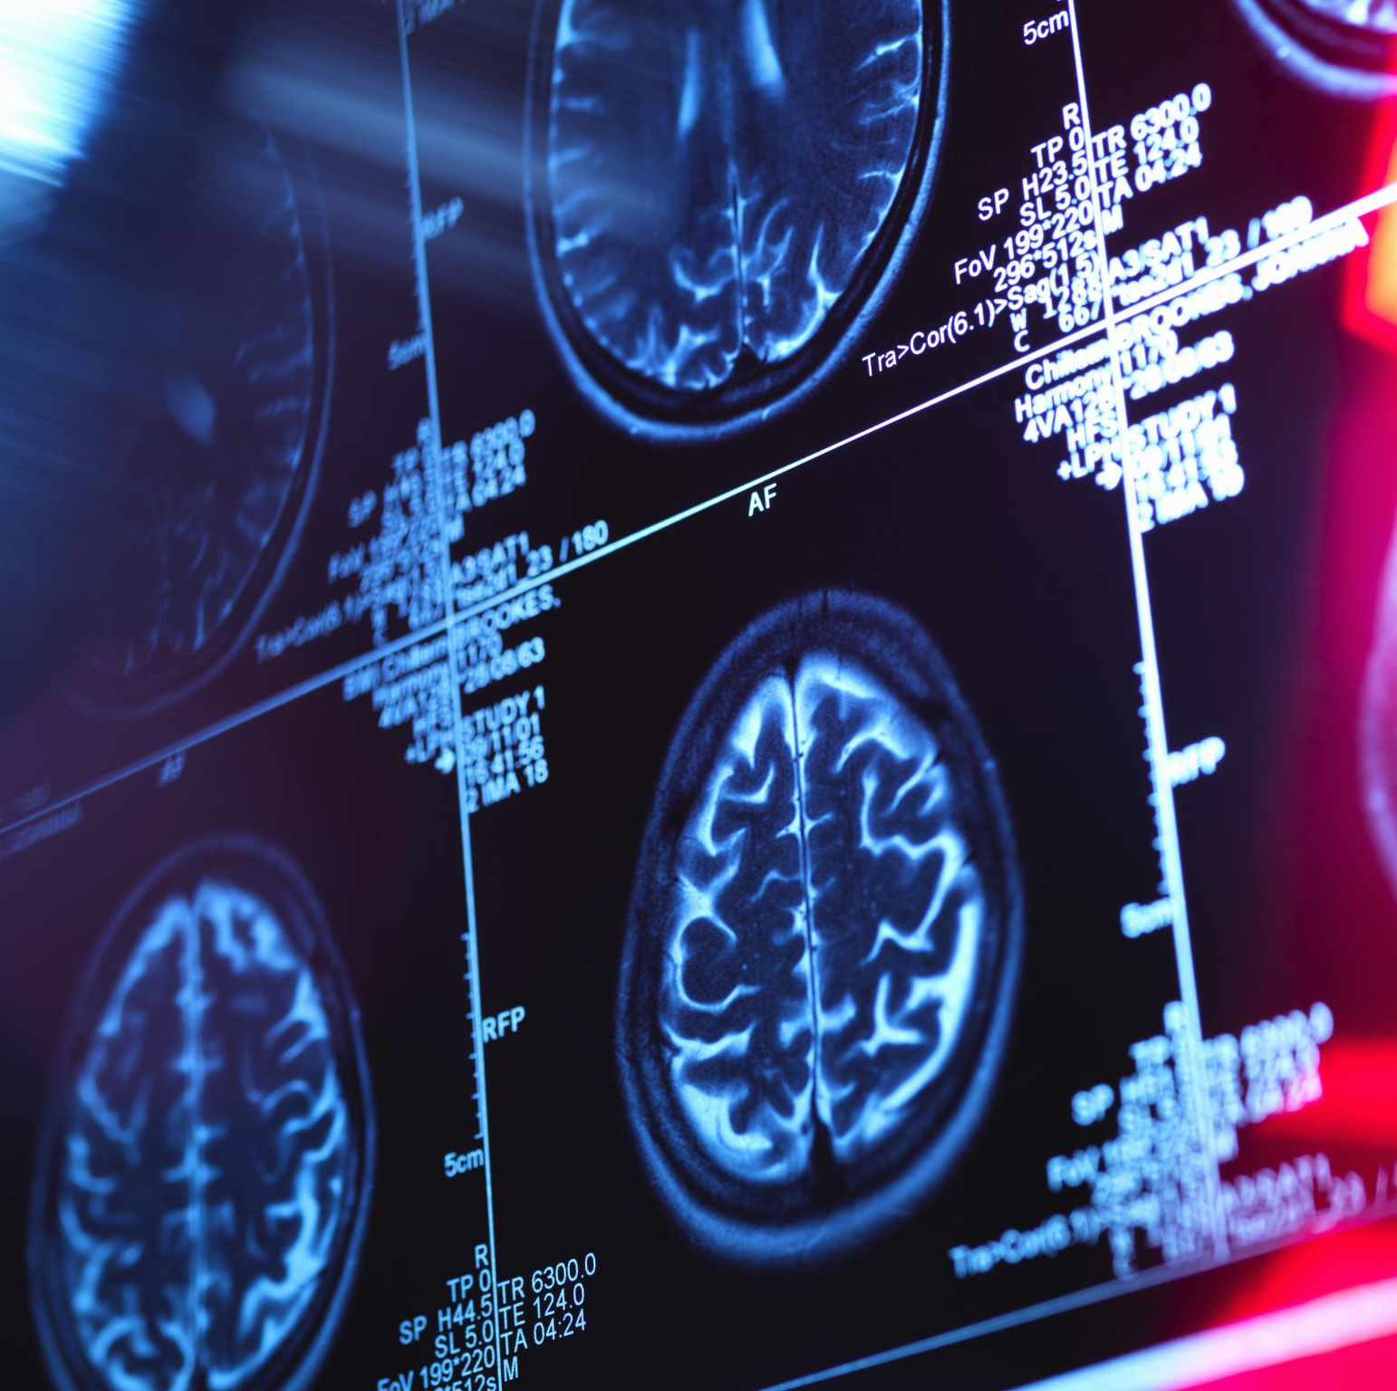
Overall Question- Is Complicated Grief illness pathology?
One perspective-
“Complicated grief is not an illness or disorder but instead a normal, human response to naturally complex life and loss circumstances.” (Dr. Alan Wofelt)
The wilderness of complicated grief-
Some people get lost in the wilderness of their naturally complicated grief. We as caregivers have the honor or helping them find safety. This is search and rescue of the human soul.

Slide 10
The following terms have been used
Abnormal, chronic, morbid, pathological, persistent complicated bereavement disorder, traumatic grief
Why utilization of using the term complicated grief?
It is a term that acknowledges that grief has encountered high hurdles of one kind or another and creates “Natural Complications.” This does not mean that it is pathological.

Slide 11
Factors that naturally influence complicated mourning
Societal circumstances
Circumstances of death
The griever’s personality
The griever’s relationship with the person that died
The griever’s loss history
The griever’s access to and use of support
Other concurrent stressors
Griever’s cultural background
Griever’s religious background
Family system
Participation in meaningful ceremonies
Griever’s counseling experience to date

Slide 12
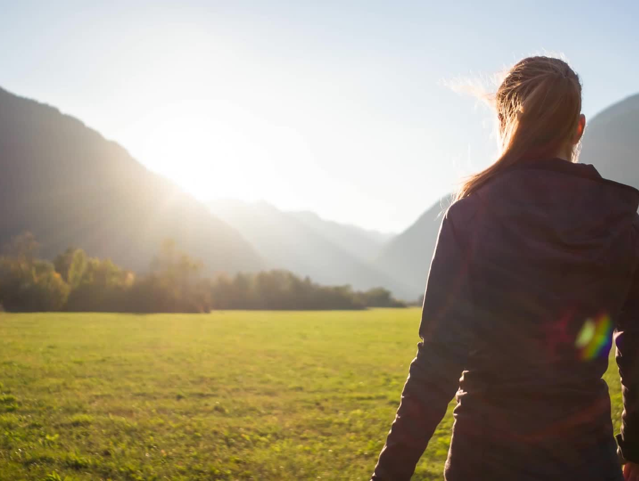
Can you think of an example for each category?
Can you think of additional factors that aren’t included in this list?
How do you think each of these factors might impact grief?

Slide 13
Discussion
Is COVID 19 itself a factor contributing to complicated grief?
https://www.nbcnews.com/think/opinion/covid-19-pandemic-will-be-outlasted-grief-pandemic-no-one-ncna1242788

Slide 14
Enfranchising Forgotten Grievers

Slide 15
Enfranchisement as antidote to complicated grief

Slide 16
Before we look at how to enfranchise, let’s look at disenfranchised grief

Slide 17
Disenfranchised grief
Kenneth Doka
Relationship is not recognized
Loss is not acknowledged
Griever is not recognized

Slide 18
Ethical Loneliness
What happens when suffering is not held, validated, and named?
Definition: “Ethical loneliness is the experience of being abandoned by humanity, compounded by the cruelty of wrongs not being acknowledged.

