Slide 1
MASTERS OF MINDFULNESS
Blending Pop Cultural Figures with Mindfulness Based Interventions
Elisa Gambill M.Ed., LPC

Slide 2
PRESENTER BIO
School Based Clinician
Trainer with Midwest Play Therapy Institute and Corewellness CEU
Cofounder of Two Nerdy Counselors Youtube Channel
Working towards Registered Play Therapist credential
Doctoral Student at Lindsey Wilson College
Meme Queen and Pop Culture Enthusiast
Elisa.Gambill@lindsey.edu

Slide 3
Copyright Disclosure
Copyrighted 2021 Elisa Gambill M.Ed., LPC, Masters of Mindfulness. This presentation or contents from this presentation may not be sold, reprinted, or redistributed without prior written permission from the author/creator.
Direct questions about permissions should be sent to:
Elisa Gambill : elisa.gambill@lindsey.edu

Slide 4
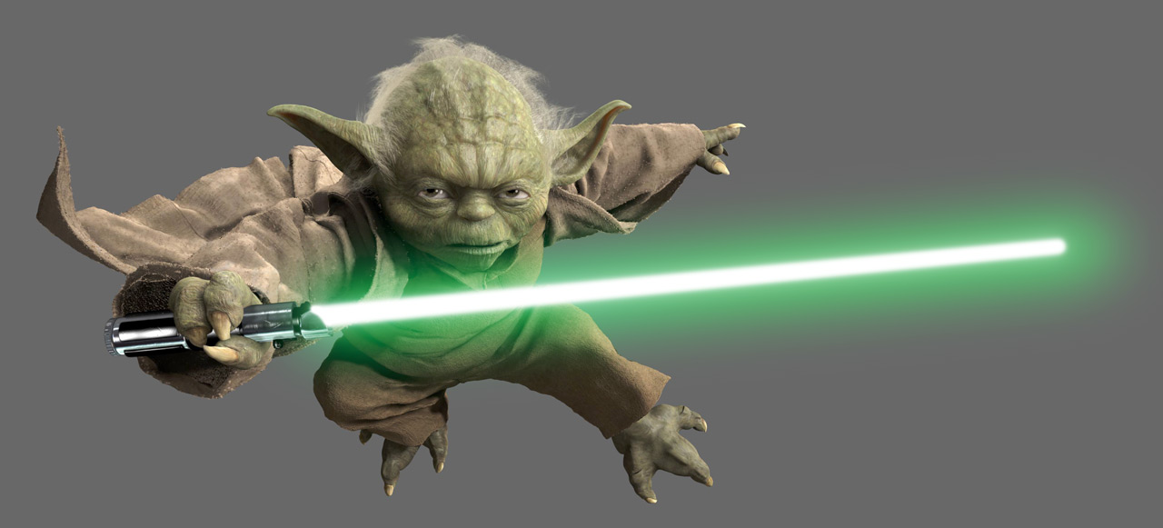
TRAINING OBJECTIVES
Discuss different theories and how they are incorporated into mindfulness-based practice.
Discuss the importance of engagement and use of popcultural figures or icons in order to improve participation and interest of the client.
Learn and practice six different mindfulness-based practices. Attendees will leave with worksheets, directions, and adaptability options for each intervention
This Photo by Unknown Author is licensed under CC BY-NC-ND

Slide 5
What is Mindfulness?
What do you think of when you hear the word mindfulness?
You don’t need to be calm, peaceful, or perfect to meditate or be mindful. Meditation is a workout for your mind. It is a purposeful way to train your mind to be however you want it to be at a given moment. Mindfulness is all about being with what’s happening in the present moment- seeing it and allowing it to just be as it is, right now.
While it is important to recognize that mindfulness meditation has roots in Buddhism, the practice and ideas shared in this training can be used by anyone from any background or religious tradition.

Slide 6
Mindfulness-Based Cognitive Therapy (MBCT)
Combines Cognitive Behavioral techniques with mindfulness strategies in order to help individuals better understand and manage their thoughts and emotions in order to achieve relief from feelings of distress
Developed by Zindel Segal, Mark Williams, and John Teasdale
First clinical trial was published in 2000
Incorporates principles from Kabat-Zinn's mindfulness-based stress reduction modality, an 8-week program designed to help people cope with the mental and physical effects of health concerns
Bernard and Teasdale's ICS (interactive cognitive subsystems) model; ICS is based on the premise that the human mind possesses different modes for receiving and processing data, the two primary modes of which are the “being” mode and the “doing” mode
The MBCT program emphasizes the “being” mode, as this mode is believed to promote lasting emotional change, specifically for individuals experiencing recurrent depressive episodes
This Photo by Unknown Author is licensed under CC BY

Slide 7
People can learn how to use cognitive methods and mindfulness meditation to interrupt the automatic processes often triggering depression
Low mood, negative thoughts, and certain body sensations such as weariness and sluggishness often occur together during an episode of depression
Researchers have found when people with a history of depression experience a low mood, they may also experience negative memories and thoughts from the past, which may, in turn, lead to worry about the future and physical sensations such as fatigue
MBCT helps participants learn how to recognize their sense of being and see themselves as separate from their thoughts and moods
This therapy is delivered as a weekly group treatment program over the course of eight weeks. Each weekly session lasts for two hours, but completing a 45-minute homework assignment six days a week is also required. For homework, participants listen to audio recordings and practice mindfulness meditation.
Over the past 15 years, the results of numerous randomized controlled trials have demonstrated that MBCT can be a powerful intervention for people who have experienced clinical depression three or more times. Evidence indicates MBCT may reduce the rate of relapse for individuals with recurrent depression by 50%. MBCT has also been applied to mood and anxiety concerns other than depression, with reported success. A 2014 review of the usefulness of MBCT as a treatment modality for several health conditions found the approach may be effective when addressing issues such as depressive relapse, current depression, residual depression, bipolar, anxiety, food and eating issues, and psychosis, among others.

Slide 8
Limitations of MCBT
Long term effectiveness has not been studied as it is still considered a new approach
Evidence supports the approach but needs more long term effects studies on how it affects individuals and diagnosis that aren’t depressive dx
Criticized for small sample sizes, lack of control groups, and lack of randomization which could skew the research findings
Needs more research done to prove effectiveness

Slide 9
Positive Psychology and Mindfulness
The close ties between mindfulness and positive psychology make sense when you consider the outcomes of mindfulness: increased positivity, a greater sense of coherence, better quality of life, more empathy, more satisfying relationships, and greater hope (Vago & Silbersweig, 2012)
Is easily incorporated into the PERMA Model of Wellness; being mindful of your thoughts and emotions promotes well being, increase use of mindfulness improves your working memory, mindfulness helps focus and use your own strengths, using mindfulness often can reset your “happiness” point at a higher level, increases individual’s resiliency, and shrinks the stress region of the brain

Slide 10
Another link between mindfulness and positive psychology is that mindfulness increases well-being and positive mental qualities, including compassion. Mindfulness-based meditation has been used in compassion training, which would result in increased sensitivity to one’s self and others’ needs. By being empathetic, we would be more motivated to help others. In return, this facilitates greater compassion and gives us feelings of joy and satisfaction. In other words, they create a circle of joy (Cebolla, 2017)
Studies have shown that mindfulness taught since childhood would do more than increased positivity, greater compassion, and diminishing stress and negativity. It would also help with focus, emotion regulation, engagement, and future career satisfaction, which would solve many problems

Slide 11
Importance of Mindfulness
Mindfulness can make clients, especially children, feel more empowered. They are able to control the exercise, focus on reaction, and learn new skills for future use.
The exercises associated with mindfulness assist with building coping skills that give the client autonomy in order to decrease symptoms caused by external or internal factors.
It also promotes positive self talk, love, and acceptance which then work towards combating negative self talk.

Slide 12
Setting the Stage for Mindfulness
You can’t do it wrong.
If you approach it as homework, it will feel crappy like homework.
The goal is not to make everything happy or calm.
Mindfulness isn’t asking you to sit back and let the world walk all over you.
You definitely won’t stop thinking when you slow down.
If you ever feel overwhelmed try to remember that even if it feels intense or scary, you are ok.
People call it the Practice of mindfulness for a reason.

Slide 13
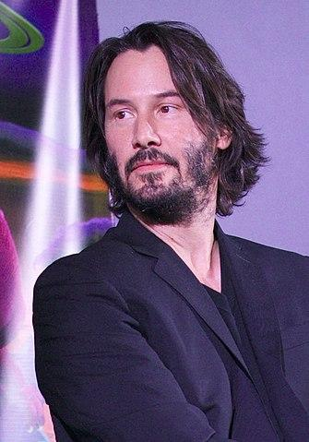
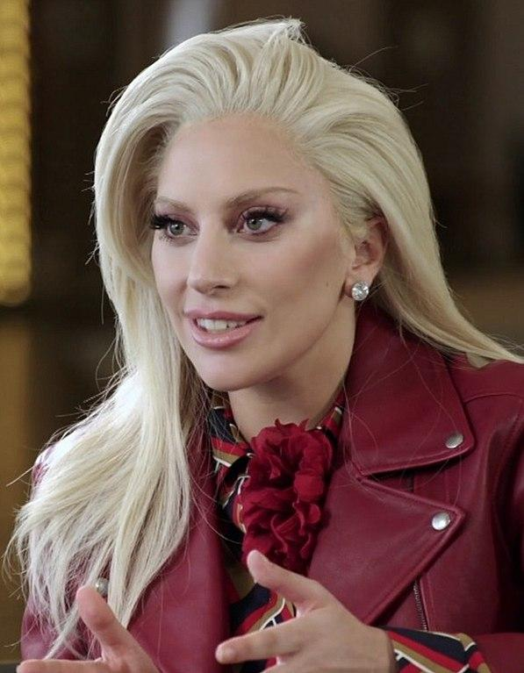
Who Do You Know That Uses Mindfulness?
Lebron James
Derek Jeter
Hugh Jackman
Keanu Reeves
Chloe Grace Moretz
Katy Perry
Big Sean
Kendrick Lamar
Lady Gaga

Slide 14
IMPORTANCE OF POP CULTURE FIGURES
Engagement
Safety
Creativity

Slide 15
Stretching Our Mindfulness Muscles
Sit in a relaxing position with head, neck, and chest aligned legs uncrossed, feet flat on the floor, and hands on or close to your kneecaps
Keeping your shoulders steady, bring your head slowly to the ring, take three relaxed breaths, starting with an exhale, repeat on the other side
Keeping your shoulders steady, bring your left ear to your left shoulder without moving the shoulder, take three relaxed breaths, repeat the same for the right side
Keeping your body aligned, slowly tilt your head to look at the ceiling until you are at your own comfortable limit. Take three relaxing breaths and repeat with looking towards the ground.
Place the lower parts of your palms on either side of your upper cheek bones, close to your temples. Begin to make small circular movements with your palms, moving downward. One you reach your jawbone, move upward, and then follow any bony parts of your face.
Make loose fists with your hands, placing palm and knuckles at the bottom of your eye sockets and pressing gently against the socket bones. Move your knuckles slowly toward your temples. From the temples, move slightly up, pressing your eyebrows and forehead. Repeat this routine several times. Carry on pressing your knuckles on any bony parts of your face.

Slide 16
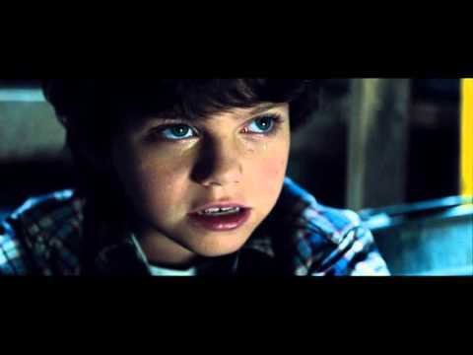

Slide 17
MR. MIYAGI’S MANTRA BREATHING
Video gives instruction for focused breathing
Gong Breathing
Bubble Breathing
This Photo by Unknown Author is licensed under CC BY-NC

Slide 19
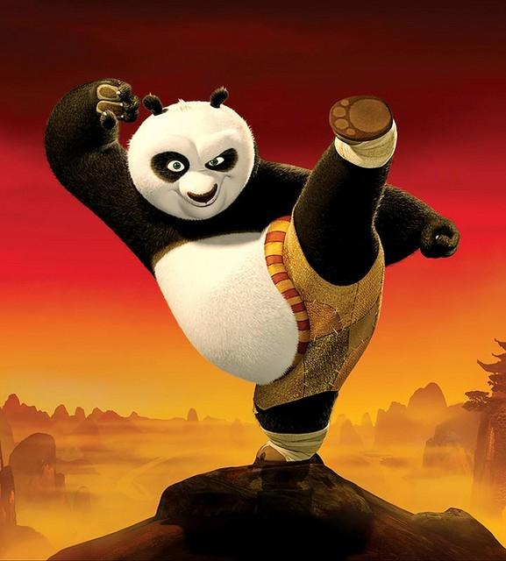
Inner Peace and Kung Fu Panda
Watch the first clip that discusses and introduces the idea of “inner peace”
I have utilized this intervention for children and adolescents who tend to focus on negative energy and ruminate on past events
Talk about how they can relate to Po or how can they relate to Master Shifu in the first clip
Discuss how Po was the underdog and noone really believed in him and his journey
This often resonates with clients that are labeled early within school settings for behavior problems
Be creative, let loose, and work together to determine physical ways to find inner peace
The second clip can be used after the student starts to find their way with self awareness, self regulation, and mindfulness based interventions

Slide 20
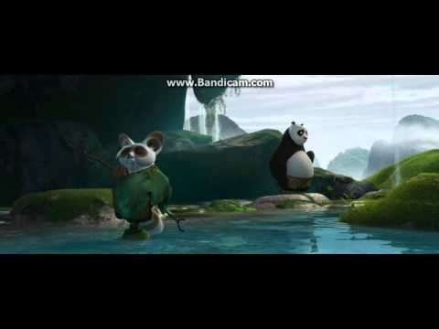
Clip #1

Slide 21
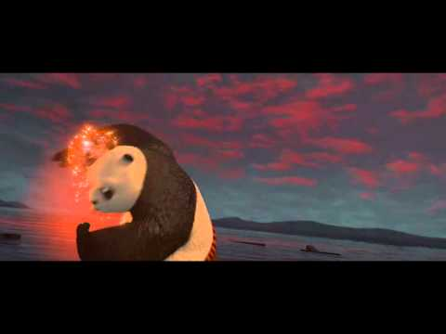
Clip #2

Slide 22
NINJA-ROMETER CHECK IN
Use after establishing rapport and appropriate for ages 3 and up
Promote use within the home and other family members to normalize dysregulation and need for coping skills
Strengthens independence to engage in coping skills without needing a trusted adult’s intervention
This Photo by Unknown Author is licensed under CC BY-NC-ND

Slide 23
Tell the client today we are going to think about your (anger, sadness, worry, stress) in three different ways: by color, number, and with words.
Discuss the differences in levels of the emotion. Normalize the ability that we can go from calm to furious but that it takes an escalation of the emotions. Use the opportunity to discuss the need for being aware of our emotions and body reactions. Promote the need to “take good care of ourselves to not always get to the red part.”
Use the character and their personality traits to connect the activity with the client. “Are you using Leo’s calm head, or have you started to raise to Raphael’s anger?” “Was your behavior in class really silly like Mikey or did you focus like Donnie?”
Adaptable for other fandoms based on personality traits

Slide 24
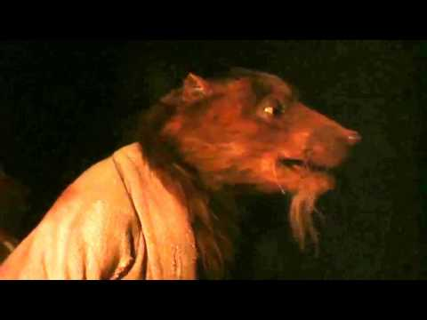
Facing Our Anger
Primarily used with client’s who are hesitant to identify, express, or admit their own anger
Watch the movie clip to show parallels between the client and Raphael
Opens a discussion on how we can confront our anger with supports and not alone
Focuses on learning the words and expressions to get the anger out
Can be conducted into narrative interventions to externalize the problem
Also can lead into Anger Chair Technique type interventions

Slide 25
DR. STRANGE AND THE STOP POWER
Open discussion on Dr. Strange and how his superhero power is to stop or slow down time
Connect that kids are able to have the same superhero power
Hand out STOP worksheet
Go through the exercise with the client
When you get to the “O” incorporate the 5 sense grounding technique
Set a timer and complete the activity once together; try a second time in silence then process the experience
Connect how client can use this
https://www.youtube.com/watch?v=iwLaB_O6IWg&list=PLttdu-Y-SjaX_8FMUTFtq1wY62eYMBujT&index=4&t=0s
This Photo by Unknown Author is licensed under CC BY-SA

Slide 26
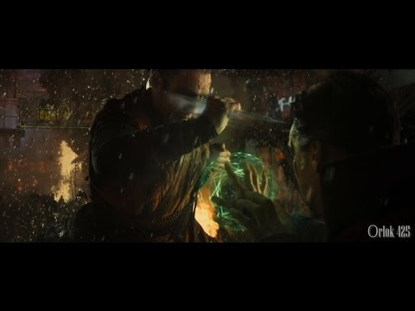

Slide 27
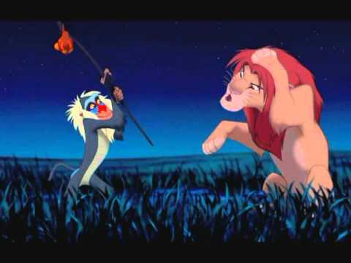

Slide 28
RAFIKI AND NATURE INTERVENTIONS
Just looking at nature scenes reduces release of cortisol, blood pressure, and heart rate
Increase brain activity empathy and altruism- same areas that are more active with emotional stability and positive outlook
The absence of multiple stimuli gives the calming affect on the brain therefore allowing it time to “rest”
Nature Walk, Nature Picture, Nature Mandela
Incorporate song or use a walking stick to emulate the feeling of Rafiki also promotes “here and now”
This Photo by Unknown Author is licensed under CC BY-NC-ND

Slide 29
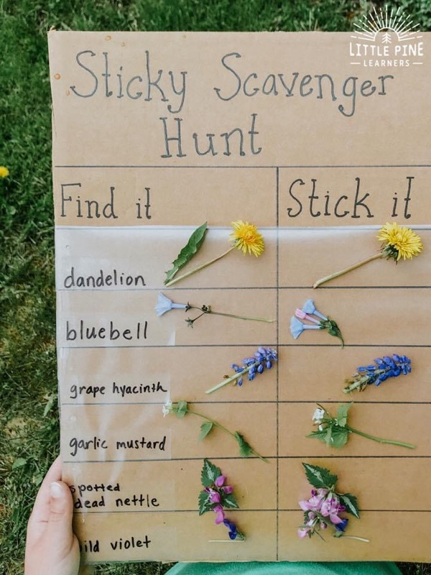
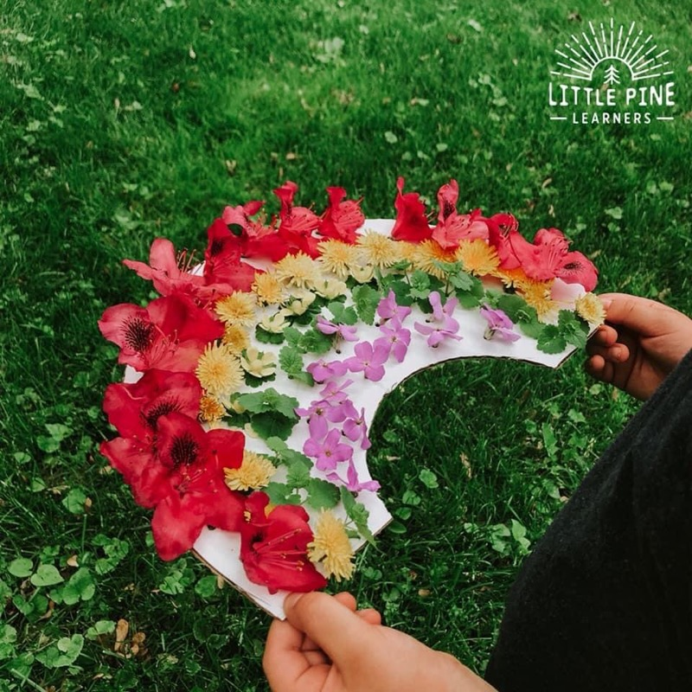

Slide 30
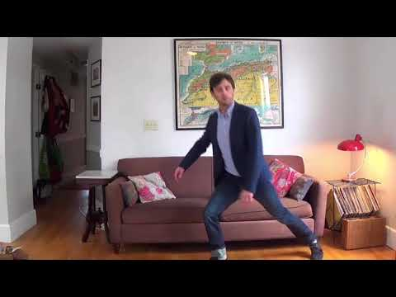
Mindfulness Silly Walk

Slide 31
INFINITY STONES OF STRENGTH
This Photo by Unknown Author is licensed under CC BY-SA-NC

Slide 32
STRENGTH AND MINDFUL STONES
Introduce the idea of how everyone has strengths and assist the client in identifying their own strengths
If using the VIA characters strengths good place to plug them in
Allow the student to choose a stone that they feel is right for them which promotes autonomy
Prompt the client to decorate the stone in a way that symbolizes the strength
After the stone is dry the client is allowed to take the stone with them and when they are feeling emotions rising, they are able to hold, carry, rub the stone to “give them the strength they need.”
This Photo by Unknown Author is licensed under CC BY-SA-NC

Slide 33
No Talk Calm Down
“If you see me holding this no talking _____,
It means I need it calm,
To clear my head and think things through,
No need to be alarmed.
Please give me time to figure out,
What I am feeling inside,
The quiet will help me think it through,
The stick will be my guide.”
Adaptable to light saber, wand, ball, whichever medium will connect with the client
Called the “Calm Down _____” or “No Talking _____”
Can be used at home, placed in plan at school, or when at other social places
Easily manipulated on size due to where it will be utilized
This Photo by Unknown Author is licensed under CC BY-SA

Slide 35
Jump Into The Picture
Provide pictures of different travel, family, places type magazines. You and the client each chose a picture that makes them feel nice, comfortable, happy, and/or calm when looking at it.
You are going to count to three and at three we are going to pretend we jump into the picture together. (The counselor should demonstrate first)
Once I am finished, we will count to three and jump out of the picture. Then we can process how we feel.
Page 157-158 Regulation book for example
Can add the photo to a sensory bag, can become a “base of operation” for the client. Incorporate different superhero, movie, and other places as their pictures.
Also promotes connection to the five sesnse

Slide 36
Theme Song Zone
Encourage student to find a song that brings positive emotions from them
A singer they relate to or lyrics that speak to them in this moment
Listen to song on a louder volume or with headphones on
Encourage student to shut their eyes and just enjoy the moment with the song
Process how their body, mind, and overall feel after listening to the song

Slide 37
CAPES AND SHIELDS OF MINDFULNESS
Adaptable to which ever fandom a student is interested in. Have the client explore what they like about that specific superhero or character. How does the client want to be like him?
Get a shield or cape from craft store.
Allow client to make small reminders of coping skills and decorate the cape or shield. Wear and practice during session.
Call it their “invisibility” super power to carry these sentiments with them outside of the counseling session.
This Photo by Unknown Author is licensed under CC BY-NC-ND

Slide 38
Create Your Base
Creating a client’s safe space
Should be reflective of things that assist client in coping skills and promote positive emotions
Can be called “lair, homebase, fort, common room”

Slide 39
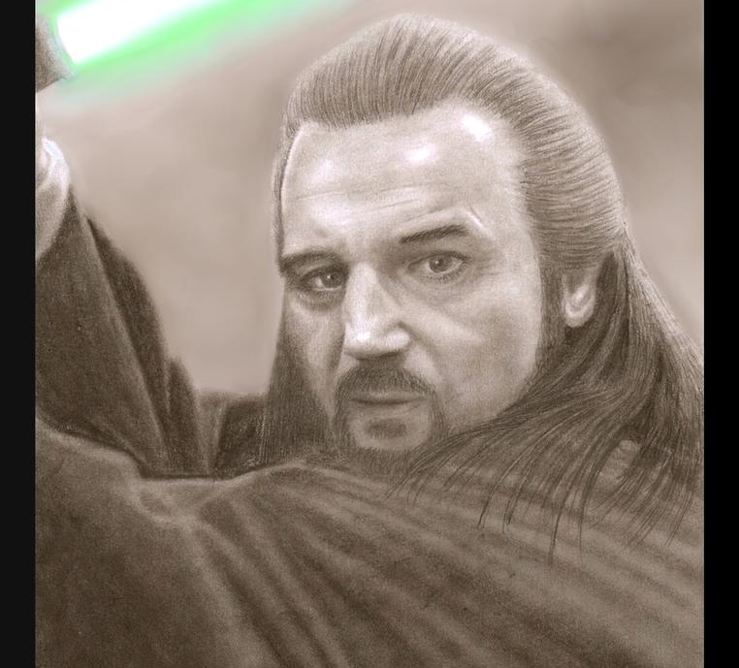
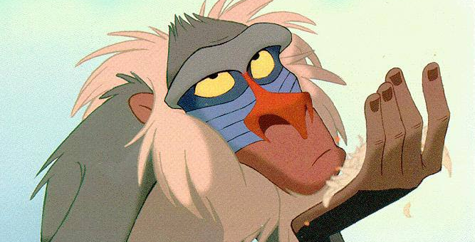
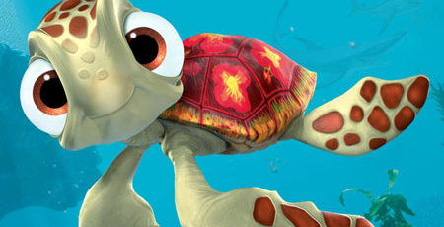
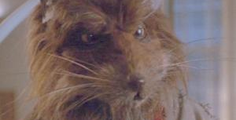
WHAT KIND OF MASTER ARE YOU?
This Photo by Unknown Author is licensed under CC BY-NC-ND
This Photo by Unknown Author is licensed under CC BY-NC-ND
This Photo by Unknown Author is licensed under CC BY-SA
This Photo by Unknown Author is licensed under CC BY-NC-ND

Slide 40
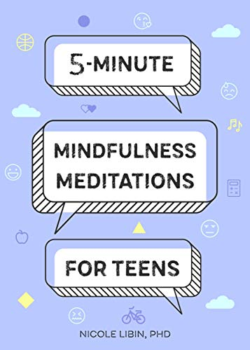
RESOURCES

